Slide 1

Academic Writing
Select the 3 lines icon to open up the Sessions menu
Use emojis to share reactions
Use Chat to ask and respond to questions
Say ‘hello’ while you’re waiting for us to start!
Mute microphone when not talking
FET Librarians
Spring 2022
Select the purple chevrons to open the Collaborate panel. This is where Chat is.
There is no need for you to share your video
Click on your name to Leave Session or give feedback
Raise hand to let presenter know you want to speak

Slide 2
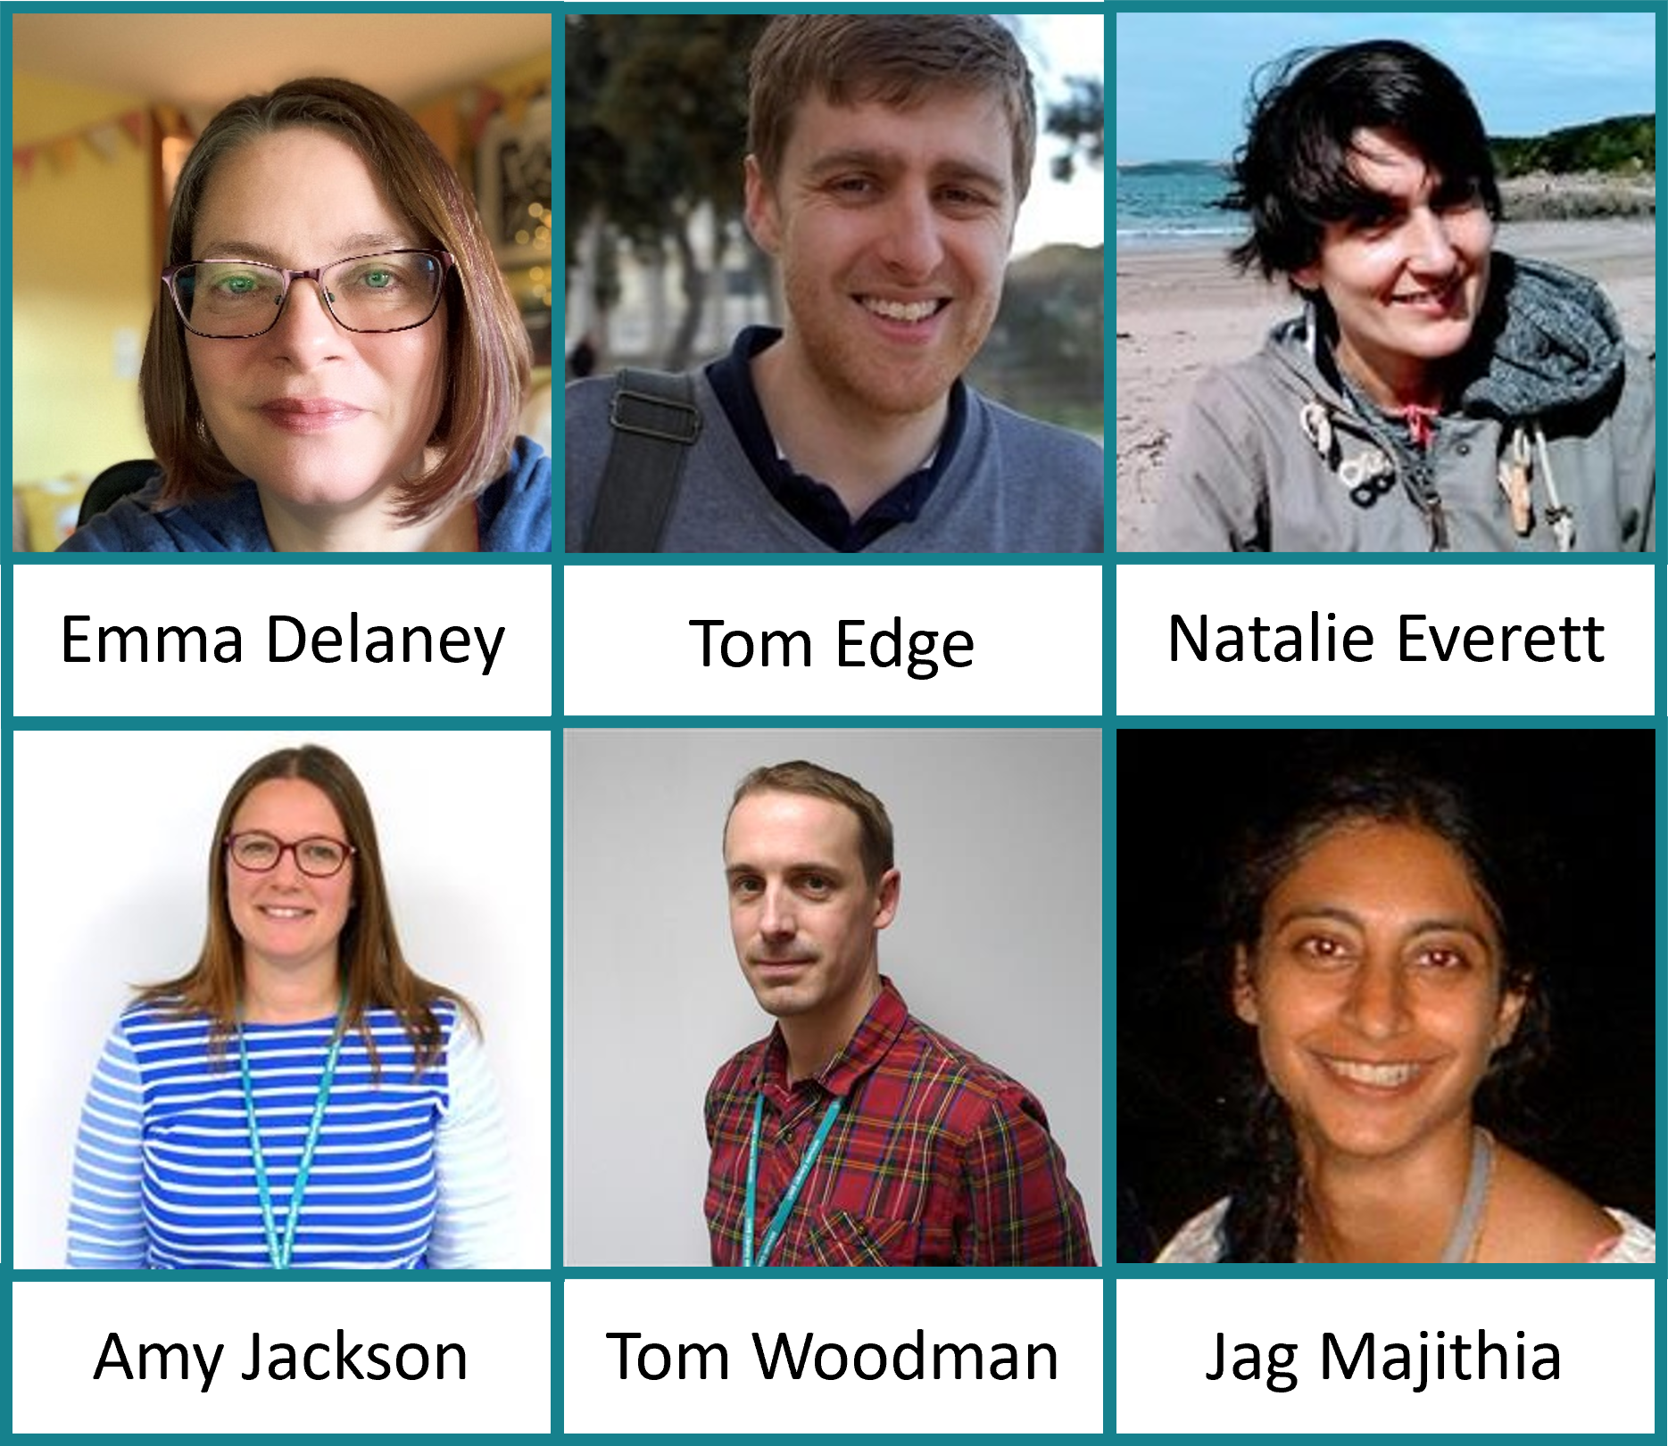
Meet the FET Library team

Slide 3
Prepare
1. Open Menti.com and join the session (code will be shown on screen and in the chat):
https://www.menti.com/u788dq1rj5
Keep this open throughout the session.
2. Open this extract and note taking template:
https://go.uwe.ac.uk/CSCTTB3
You will need this to take part in the practice activities

Slide 4
Last time
Analysing a topic
Keywords and search terms
Search tips and tricks
Where to search
Library Search
Databases
Scopus
Evaluating sources
CRAAP
Reading and Note Taking
SQ3R
Critical reading and critical thoughts

Slide 5
By the end of this session you will feel more confident…
Planning and finding structure
Critical thinking and writing
Academic writing style
Bringing it together: developing a paragraph
Notes:
5

Slide 6

Organising your thoughts
How do you generate ideas for your writing?
What steps do you take when you are starting to think about a topic?
What questions do you ask yourself?
What sources of information might you look at?
Post ideas on the Menti
Photo by Thought Catalog on Unsplash

Slide 7
Generating ideas
Some possibilities:
What is my initial response to the question?
What do I already know about the topic? Write everything you know about the topic on a sheet of paper or on a Word document or make a mindmap
What else do I need to find out to answer the question?
What is the focus of your reading list or the module content so far? Gather all your notes in one place and skim read these as a reminder of the area.
Do a quick Library search to see what has already been written about the topic.

Slide 8
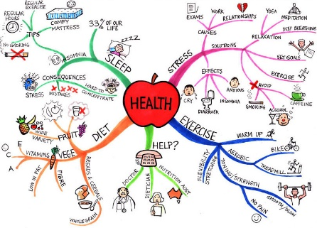
Mind Mapping
Mindmapping software and apps

Slide 9

Finding structure
1) Title
2) Introduction
3) Main argument – evidence + evaluation
4) Alternative argument – evidence + evaluation
5) Alternative argument 2 – evidence + evaluation
6) Conclusions

Slide 10
The writing and editing process
The rough draft
Working document
Refined edit
The final document
Assignment Planner
Managing Your Time
How to improve your work before submitting

Slide 11
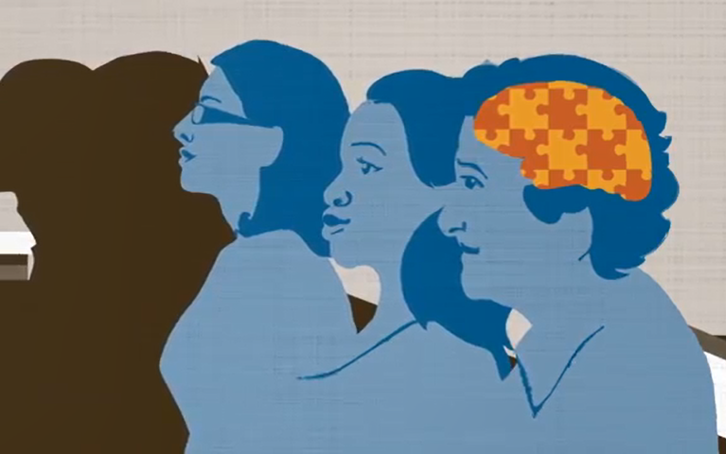
What is Critical Thinking?
Asking questions
Taking a step back
Going in search of evidence and assessing what you find
Not believing everything, but not disbelieving everything
Not just finding flaws
Constructing your own independent point of view
Video: https://youtu.be/HnJ1bqXUnIM (2m 29s)

Slide 12
A well cultivated critical thinker:
Paul,R. and Elder, L. (2019) The Miniature Guide to Critical Thinking Concepts and Tools [online]. 8th ed. Lanham: Rowman and Littlefield. [Accessed 05 November 2021].
raises vital questions and problems, formulating them clearly and precisely
gathers and assesses relevant information, using abstract ideas to interpret it effectively
comes to well-reasoned conclusions and solutions, testing them against relevant criteria and standards
thinks open-mindedly within alternative systems of thought, recognizing and assessing, as need be, their assumptions, implications, and practical consequences
communicates effectively with others in figuring out solutions to complex problems
is scrupulously careful not to misrepresent or distort information in developing an argument or position, and sees through false information and fake news.

Slide 13

Key Features of Critical Writing
Photo by Aaron Burden on Unsplash
Content​
Selection of points​
Clarity of language​
Structure​
Linking of points​
Adapted from: Cottrell, S. (2017) Critical Thinking Skills. 3rd ed. Basingstoke: Palgrave Macmillan.​

Slide 14
1. Content
Background information/description is minimal. It analyses the evidence presented by expert writers, looking for strengths and weaknesses, and uses the evidence to build an ‘argument’. ​
Adapted from: Cottrell, S. (2017) Critical Thinking Skills. 3rd ed. Basingstoke: Palgrave Macmillan.​

Slide 15
2. Selection of points
A good critical writer (GCW) knows which aspects of the topic are the most debated, and will cover the range of opinions. This relies on critical reading of the correct sources.
Adapted from: Cottrell, S. (2017) Critical Thinking Skills. 3rd ed. Basingstoke: Palgrave Macmillan.​

Slide 16
3. Clarity of language
Points are presented so that a general reader can understand. Good writers check through their writing several times i.e. edit.
Adapted from: Cottrell, S. (2017) Critical Thinking Skills. 3rd ed. Basingstoke: Palgrave Macmillan.​

Slide 17
4. Structure
GCWs group together similar viewpoints and analyse them before looking at alternative viewpoints. This is more logical for the reader.
Adapted from: Cottrell, S. (2017) Critical Thinking Skills. 3rd ed. Basingstoke: Palgrave Macmillan.​

Slide 18
5. Linking of points
GCW is planned out well so that the most important points stand out clearly. Good signposting helps the reader to understand the sequence used by the writer.
Adapted from: Cottrell, S. (2017) Critical Thinking Skills. 3rd ed. Basingstoke: Palgrave Macmillan.​

Slide 19
5 critical questions
Why are you reading this particular text?
Why did the authors write it?
Can you summarise what is relevant to you?
What are they saying? Are you convinced?
How might you use the text for your purposes, in the light of its content and your evaluation of the authors’ argument?
critical reading
critical writing
critical thinking
Adapted from Wallace, M. and Wray, A. (2016) Critical Reading and Writing for Postgraduates. 3rd ed. Los Angeles: SAGE.

Slide 20
Critical Writing
Descriptive writing | Critical writing
States what happened | Identifies the significance
States what something is like | Evaluates (judges the value) strengths and weaknesses
Gives the story so far | Weighs one piece of information against another
States the order in which things happened | Makes reasoned judgements
Explains what a theory says | Shows why something is relevant or suitable
Explains how something works | Indicates why something will work (best)

Slide 21

Descriptive or Critical – Quiz!
Test your knowledge!
Menti.com Quiz
4 sentences
How could you tell?
Image by Garaz from Pixabay

Slide 22
Critical Language – Linking words
Academic Phrasebank > Being critical
How to write critically
There is, however, evidence that individual actions have created a market demand for fewer plastic products. For example, many coffee shops now offer discounts to customers using their own cups or extra charges for customers who do not bring their own cups. This could be seen as a success of classic neoliberal policy, in that markets will adjust to meet changing customer demand. Despite this, there is no evidence that the uptake of re-usable coffee cups has reduced the number of single-use coffee cups, whilst in some cases, changes to alternatives are not as environmentally sound as customers may believe.

Slide 23
Critical Language – Being Cautious
Academic Phrasebank > Being cautious
Writing in an academic style > Being cautious
CSIS workshop – Being cautious
Which is the stronger claim?
Sentence A:
The results prove that cutting down on single-use plastic production will have a significant factor in reducing ocean pollution.
Sentence B:
The results suggest that cutting down on single-use plastic production could impact on a reduction in ocean pollution.

Slide 24
Critical Language – Being formal
Writing in an academic style > Being formal
CSIS workshop – Being formal
Which of these sentences is more academic?
Sentence A:
I think it is absolutely shocking that vital personal data isn’t being protected from inappropriate uses.
Sentence B:
Chatterjee and Sreenivasulu (2021) found that individuals tend to be cautious about sharing personal data and concluded that careful implementation of regulation increased user confidence that their data would not be misused.

Slide 25
Critical Language – Being concise
Writing in an academic style > Being concise and precise
Active vs passive sentences
Redundant words
Unambiguous words
How could we make this sentence more concise?
It is quite clear to see that artificial intelligence is going to be a really key factor in the future of assessment in higher education.

Slide 26
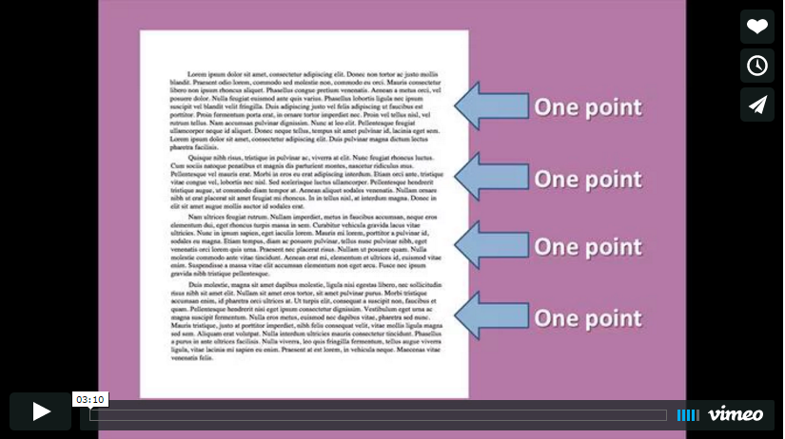
A short video on paragraphing
https://vimeo.com/48596286 (3m 10)

Slide 27
Developing a paragraph (SEE)
Statement (S)
Write a topic sentence, linking to the previous paragraph and introducing the specific claim of this paragraph
Evidence (E)
Expand this with more information e.g. examples, quotations, definitions
Compare / contrast / examine opposing ideas / give reasons/causes
Explanation/Evaluation (E)
Evaluate the evidence and draw a conclusion
Link to the next paragraph

Slide 28
Example of a structured paragraph
Bednar, P.M. and Welch, C. (2020) Socio-Technical Perspectives on Smart Working: Creating Meaningful and Sustainable Systems. Information Systems Frontiers [online]. 22, pp. 281–298. Accessed on 22 October 2020.
For many stakeholders, economic sustainability appears to be paramount. When an organization draws up its accounts, there must be a positive balance at least over the long-term or the organization’s very existence is threatened. However, traditional business reporting systems have been criticised for a narrow, financial view that is only one dimension of organizational sustainability (Elkington 1999; Willard 2012). A wider framework could embrace the ‘Triple Bottom Line’ of social, environmental (or ecological) and financial factors, or go even further towards an engaged approach extending to politics and culture (Magee et al. 2013). Perrini and Tencati (2006) describe a sustainability-oriented company as one that is fully aware of its responsibilities towards different stakeholder groups. Such an organization takes purposeful action to improve its social and ecological performance, giving consideration to socio-technical issues.
S
E
E

Slide 29
Building a strong argument
Workbook: How to improve your work before submitting > Review, Edit, Proofread
“Furthermore…”
Conclusion
“However…”
“In conclusion…”
“In addition…”
“By contrast…”
“Therefore…”
Balanced evidence to support the argument
Balanced evidence to support the argument
Introduction

Slide 30

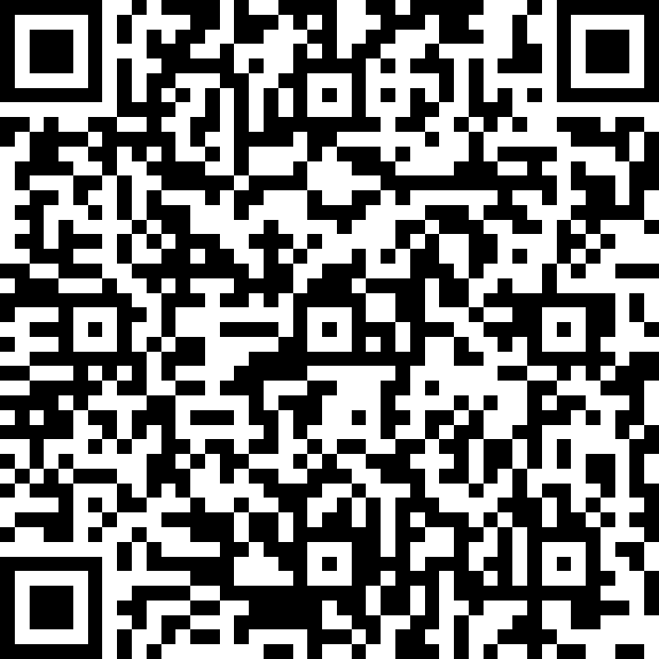
Reflection: What we’ve done today
Please provide feedback:
https://forms.office.com/r/5pXzBGLbk9
Photo by Laurenz Kleinheider on Unsplash

Slide 31
Studiosity Pilot
Pilot available for:
MSc Information Technology
MSc Data Science
Until Sept 2022
Writing Feedback
Upload a draft essay or written assignment, and get it back the same day with tips and notes on how to make it better.
Any time of day, 365 days a year, any subject, any assignment
You will receive feedback on spelling, grammar, structure, language and use of sources.
Connect Live
Ask a question, connect to a real person anytime, 24/7, 365 days a year.
They’ll help with your exact problem.
Chat back and forth, draw on the whiteboard, share a file.
All core subject areas - Maths, Science, English, study skills, and more.
Notes:
Studiosity offers ‘help, not answers’. That's why our university offers it to you.
You will reach the answer on your own, with some help. You will think about how to improve your own work, which will make you feel more confident and more prepared for next time.
How do I get access?
As a student on a programme that is piloting this service, you will get free access until the end of September.
You should find the Studiosity link in the ‘Study skills and support’ section in this Blackboard course (listed in the left-hand menu).

Slide 32
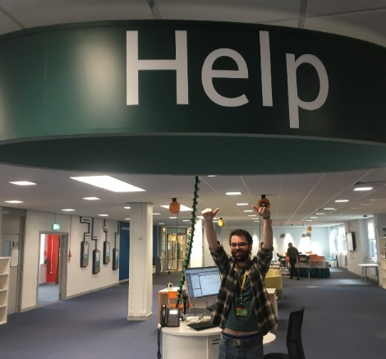
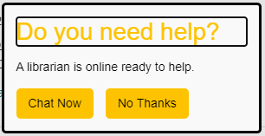

Support
Help yourself
Academic skills workshops
Study Skills webpages
Ask a Librarian (online)
Contact us
Make an enquiry (in-person)
Help Desk (Level 2)
One to One Support
Book via Infohub or Ask A Librarian
Notes:
32

